Slide 1
Analysis on Big Mountain Resort’s Ticket Price
Hiram G. Menendez

Slide 2
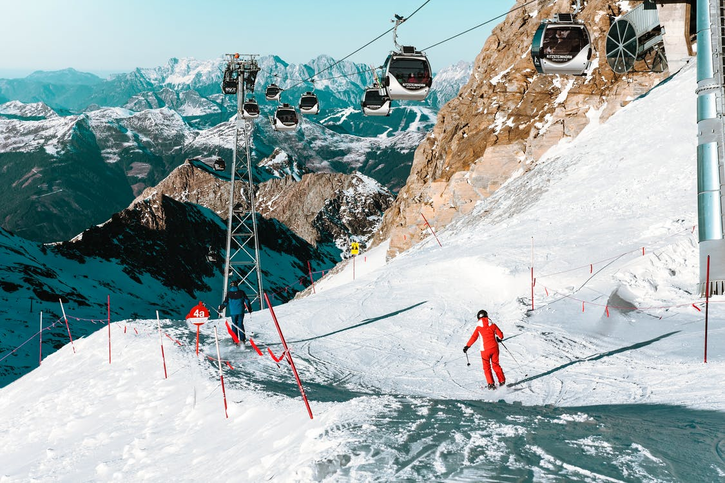
Big Mountain Resort
Popular skiing destination in Montana with a current ticket price of $81.00
Current pricing strategy is to charge a premium
However, this was not a data-driven decision
People Skiing on Snowcapped Mountain. Adapted from pexels.com by F. Daniel, 2017, https://www.pexels.com/photo/high-angle-view-of-people-skiing-on-snowcapped-mountain-287228.

Slide 3
Problem 1: What ticket price is actually supported by the facilities provided?
Problem 2: Which business proposals are likely to lead to increased revenue?

Slide 4
Data Source
Data on 330 Ski Resorts in the United States was used.
It lists 27 features from each, such as:
State in which it is located
Summit elevation height
Weekday and weekend adult ticket price
Skiable area
etc.

Slide 5
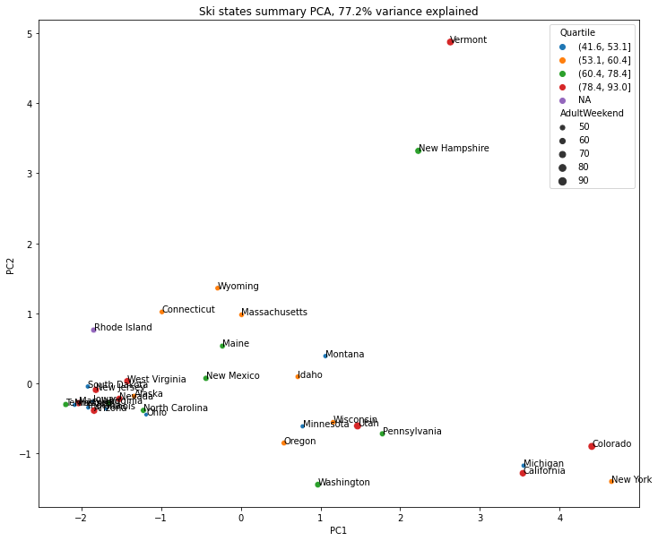
State Level Properties
No clear patterns among creatures at the state level.
Conclusion: the “state” feature is not a good predictor of ticket price.

Slide 6
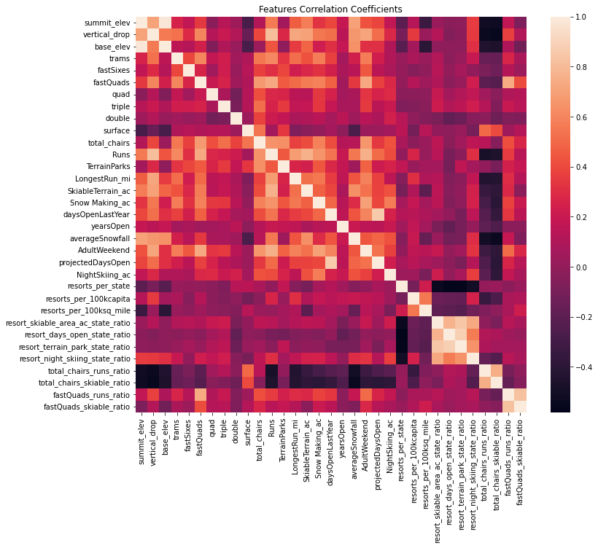
Which features are correlated?
Some features that correlate strongly with ticket price are
Number of fast four-person chairlifts
Total number or skiing runs
Total snow-making area
Total chairlifts
Feature that correlates the most is
Night skiing area state ratio

Slide 7
Model Development
Three models were developed
Dummy model that predicts the mean
Linear Model
Random Forest Model
Some aspects taken into consideration
Whether to impute missing values with the mean or median value
Whether or not to scale data
How many features to keep
How many trees to use (for Random Forest Model)
The best version of the Random Forest model slightly outperformed the Linear Model

Slide 8
Current Ticket Price: $81.00
Model Prediction: $(95.87 ± 10.39)

Slide 9
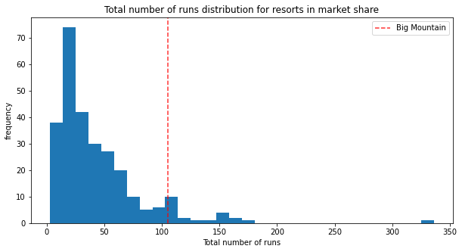
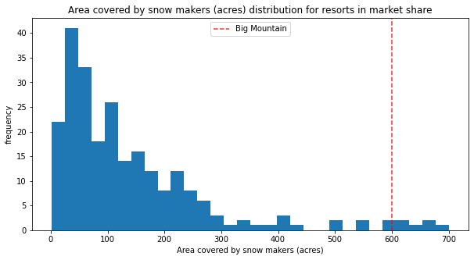
How do Big Mountain’s Features Compare to Other Resorts?
For many other features as well, Big Mountain lies above the average

Slide 10
Current Business Scenarios and Model Prediction
Scenario | Model Prediction
Permanently closing down up to 10 of the least used runs | Decrease in revenue
Adding a run to a point 150 feet lower plus and an additional chairlift | Ticket price increase: $1.99 Yearly revenue increase: $3,474,638
Same as previous while also adding 2 acres of snow making cover | Ticket price increase: $1.99 Yearly revenue increase: $3,474,638 (same as previous)
Increase longest run by 0.2 miles, requiring an additional 4 acres of snow making coverage | No difference in ticket price or revenue
Only the second proposal is recommended based on model predictions

Slide 11
Conclusions
It is recommended that the ticket price of Big Mountain Resort be increased to close to $95.87.
The proposal of adding an additional run and chairlift could likely lead to an increase yearly revenue of about $3,474,638.
The other proposals are not recommended.

